Slide 1


Reproducible Report Production using R markdown: an example using SHMI
Richard Wilson
See the report on Rpubs

Slide 2
Aim
Providing regular updates on performance, outcomes or experience as slide packs or pdfs are part of the standard work programme for analysts
Invariably they follow the same format month to month, week to week to day to day, with the same content and are time consuming and monotonous to refresh
Getting customers to interact and self-serve from dashboard tools would be great, but that requires a shift in data literacy and empowerment
So, is there a half-way house on the way to self-serve?
How about an interactive report that looks just like and reads just like a board report, but is semi-interactive, with auto generated text to guide the reader’s interpretation
A report that can be sent out with the papers and discussed at the meeting just like any another report, but is reproducible, flexible, and quick to deliver
A report that also gets the reader to start using and getting used to interactivity and exploring and digging into the charts

Slide 3
The data set: SHMI
National mortality ratio, introduced following the Mid Staffs Hospital Inquiry.
Published since March 2011
Boards required to sign it off as part of Quality Account
Logistic regression model that predicts expectation of death for every inpatient spell at non-specialised hospitals
Quality of the output is determined by the quality of the data
Data is publicly available Summary Hospital-level Mortality Indicator (SHMI) - Deaths associated with hospitalisation - NHS Digital, covering:
Indicator values
Contextual data
Model predictors
Data quality reports
Methodology

Slide 4
Why R?
Most trust are using analytical tools provided by commercial suppliers, but the data is freely available to trusts
Could I produce a tool that provided enough information without the need to charge
Open Source, free, collaboration, take and make yours
Do once for all
All in one solution from ETL to visualisation to forecasting
Markdown provides a way to produce interactive html pages, without the need for a server, unlike shiny
Automation of inline R provides basic narrative

Slide 5
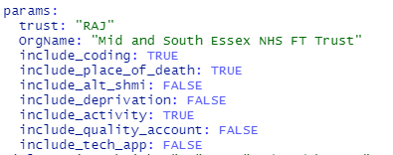
Build
Longitudinal Contextual and
Condition RDS files
Child scripts
Automation
script
Parent markdown
SHMI zip archive
Data load
Visual format and other functions
Archive copies
Can you read a zip archive on a website?
html file
Print to pdf

Slide 6
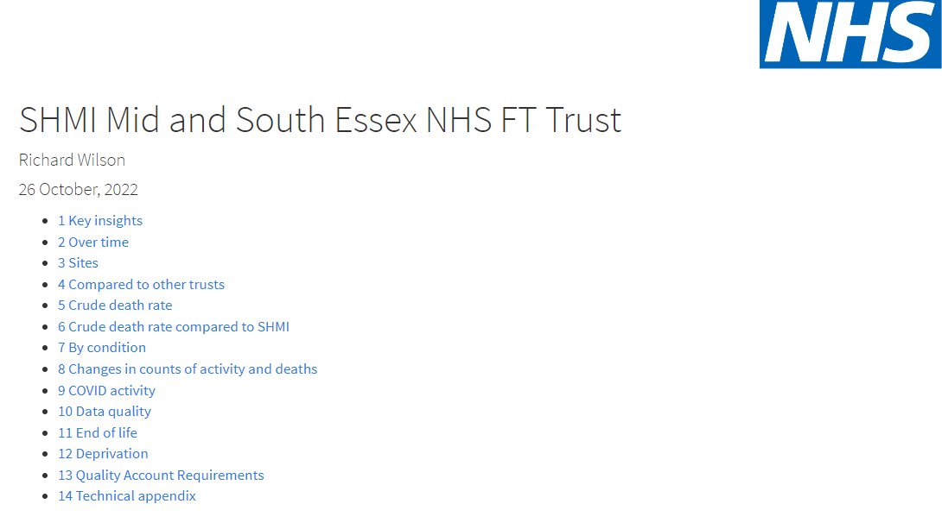
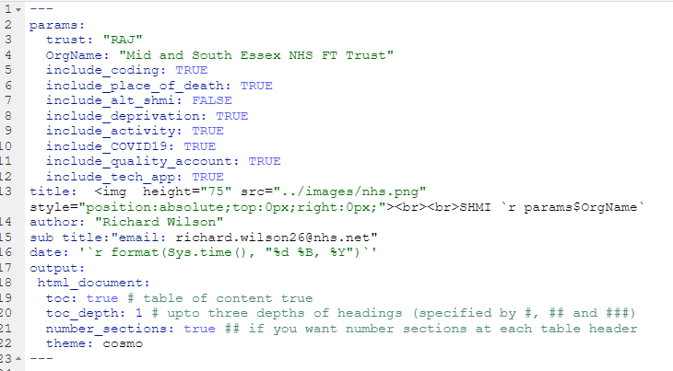
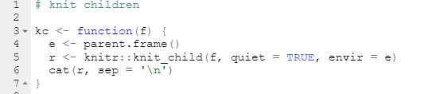

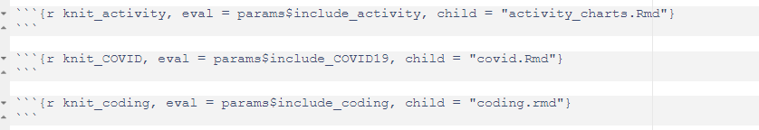
Chapters and children
toc: [table of contents] and number_sections: automates header numbers based on #, ##, ### headers,
so not manual relabelling
Knitr the children

Slide 7
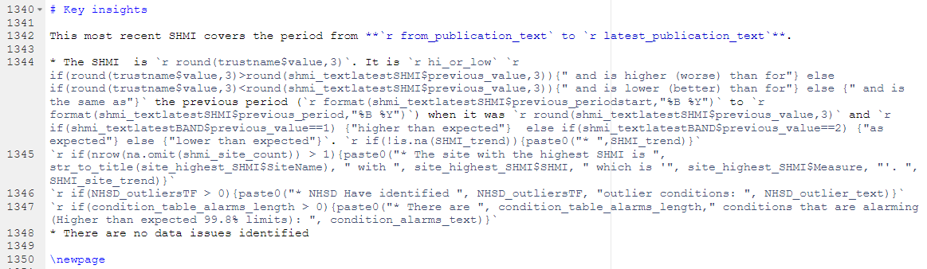
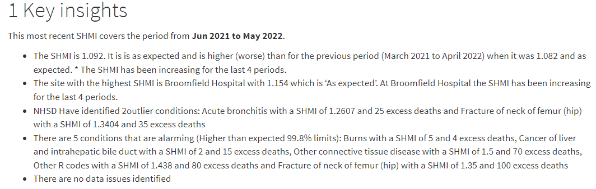
Inline r and text automation
** bold
Format(date,”%B %Y”) creates reader friendly text
Inline r using embedded if{}
If{} with nrow() or t/f controls display of text
* On new line creates a bullet point

Slide 8
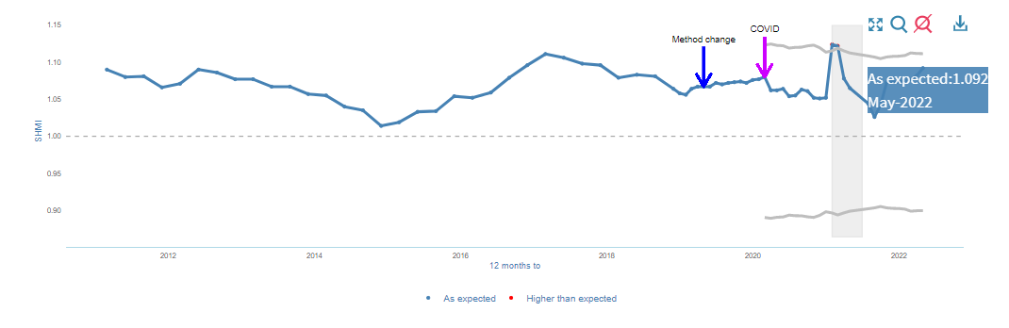
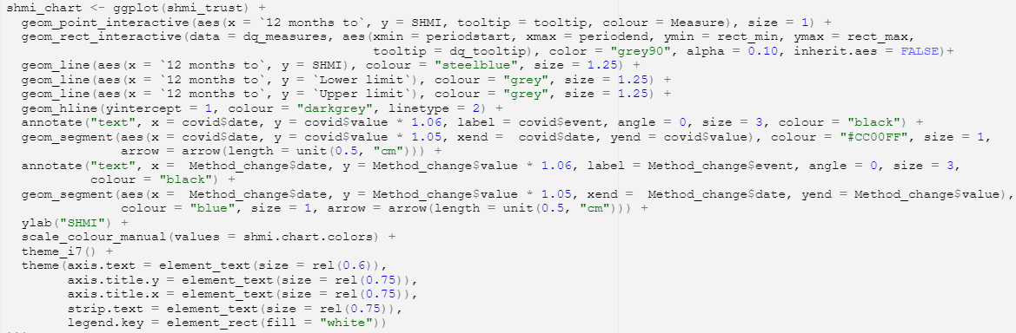
Interactivity with ggiraph

Slide 9
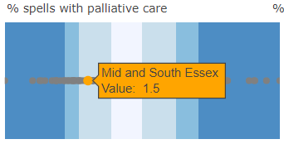
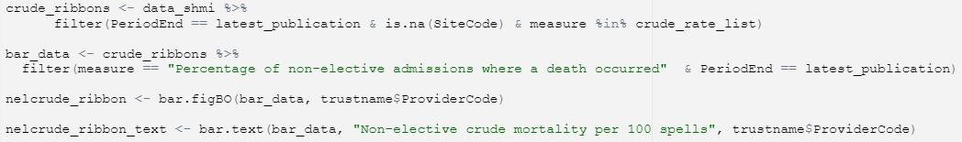
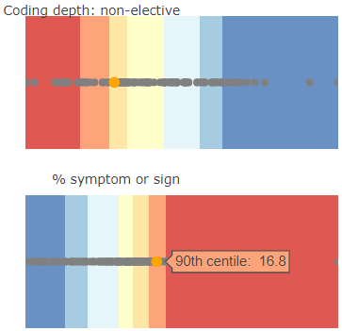
Ribbon charts
Plotly stacked bar charts with flipped axis, each ribbon is a decile
Captured in a function with three colour options:
bar.figBLB – Blue to Light to Blue
bar.figOB – Orange to Blue
bar.figBO - Blue to Orange
Function takes data.frame and trust name for the tooltip as arguments.

Slide 10

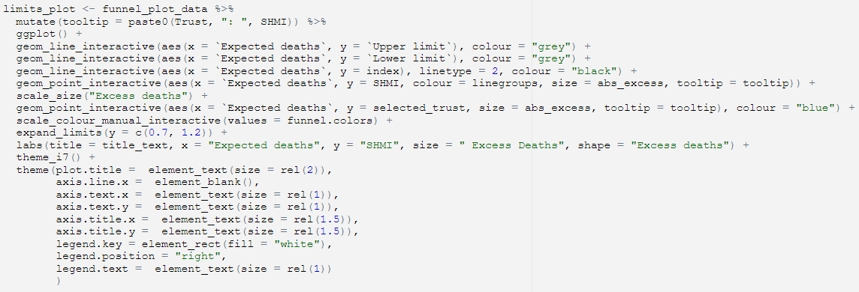
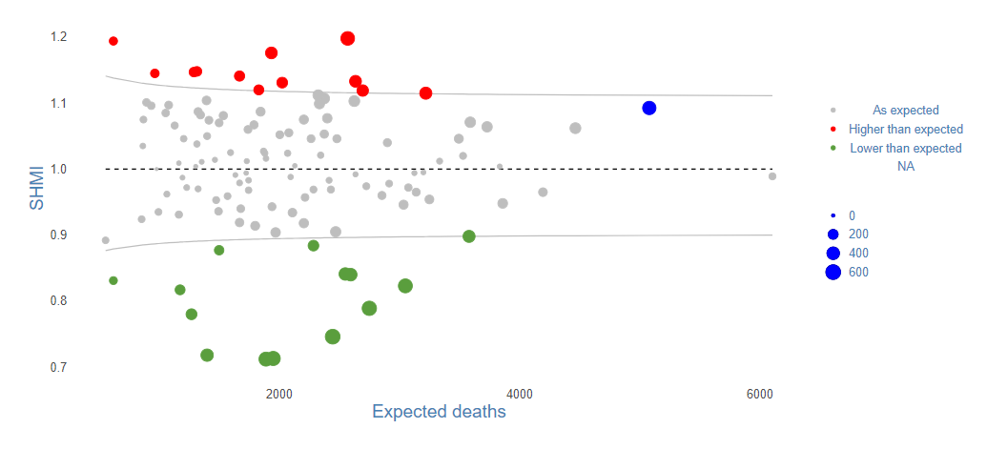
FunnelplotR
Points are scaled to be abs(excess deaths
Use a .r script to maintain list of visual formats to maintain consistency
Needs to be upgraded to v0.4.1 as throwing up warnings

Slide 11
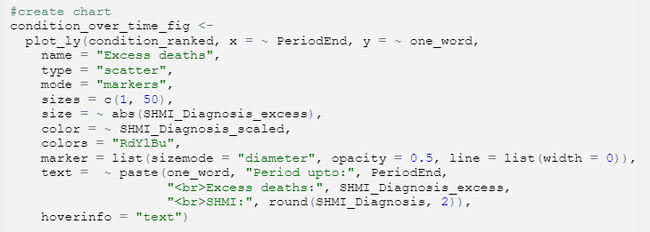
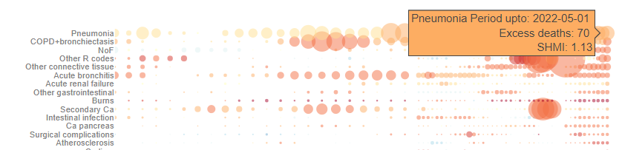
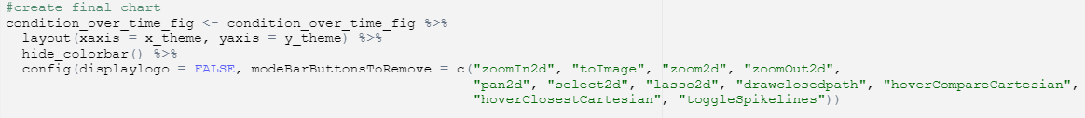
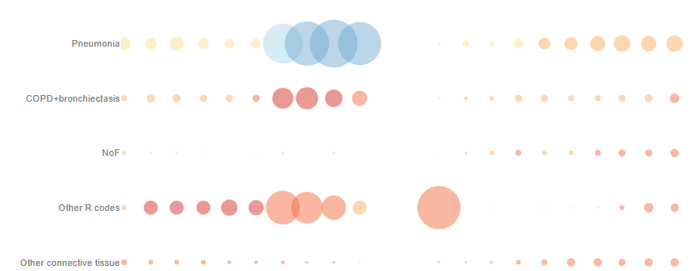

Interactivity with plotly
Fig.height is controlled by a calculation as the
number of conditions can vary between trusts

Slide 12

Other elements in the repository
DataLoad
Extracts elements from the zip archives
Calculates new measures not provided by NHSD
Addresses longitudinal changes in site and trust mergers
Directorate dashboard
Flexdashboard
Uses the SHMI extract service .csv to provide an intra-trust view of SHMI and mortality
Includes VLAD and CUSUM visualisations
SHMI predictor
Uses the model predictors applied to create a prediction of the SHMI today if nothing changed. SHMI is currently published 5 months in arrears due to HES cleaning and capturing post discharge deaths.

Slide 13
Lessons learnt
Users have accepted the tool, now seen as the norm
Really easy to run through at meetings, especially remote
Child files means nothing is ever lost, can always bring back that favourite/seasonal analysis
R is incredibly flexible, which is good and bad as lots of alternative ways of doing the same thing:
ggplot + ggirafe vs plotly
Creating inline text and narrative requires plain English column names, which means a lot of
rename(`th
is is plain English` = “not_plain_english”)
A project like this is not just for the first commit! It can become all consuming! ‘I can just do this’, ‘oh, I could use that to…’
But it is a great way to learn R

Slide 14
Next steps
Long list of potential enhancements – isn’t there always!
Now available on NHSR git-hub
Issues list with further developments
Road test it with other trusts and ICS and get more feedback
I am up for short sessions on how to be ‘that bit’
And do not mention Quartro!

